Slide 1

Learning from Lived Experience Involvement: MINDS study
Sarah Rae
29.04.25

Slide 2
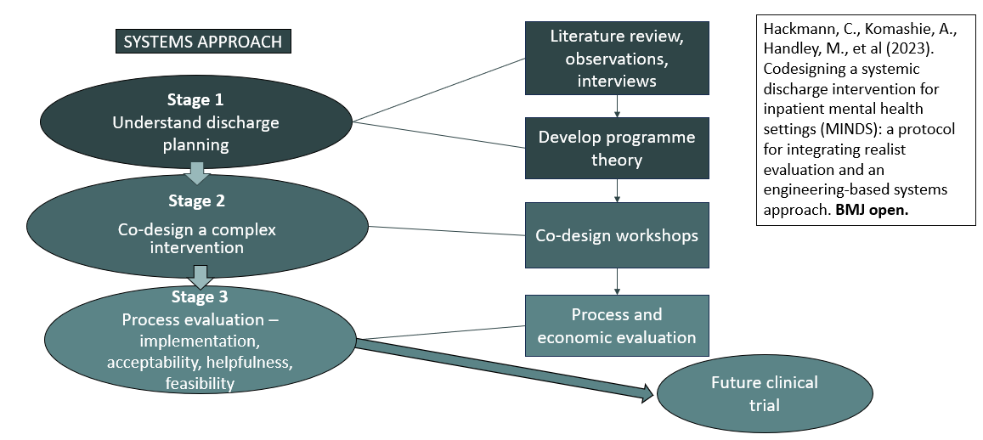
Coproducing improved mental health acute inpatient discharge using a Systems Approach

Slide 3
Embedding Lived Experience in minds
Conceived from lived experience
Sarah Rae (lived experience) and Corinna Hackmann (NSFT) are Co-Chief Investigators
Lived Experience Advisory Group (LEAG) includes 12 people with and without research experience (4 meetings per year)
Two members of the LEAG sit on the Study Steering Committee, one of whom is a Co-Chair
Each work package is co-led by a researcher with lived experience of discharge.

Slide 4
Working in a Coproductive space with the LEAG
WP1, the LEAG completed a pilot interview to test out our topic guide, helped prioritise the topics for our topic guide, and reviewed our ethics application, PIS, and consent form for WP1. Individual LEAG members also joined researchers in analysis meetings,
WP2 they collaborated with the team, influencing the structure and content of the co-design workshops, including attending the dummy run. The group was also actively involved in coproducing the Onwards Approach interventions, especially the discharge planner.
WP3, the LEAG contributed in multiple ways, including to the participant PIS and consent forms, refinement and finalisation of the Onwards Approach and had imaginative ideas about how the study findings could be disseminated more widely. They also suggested amendments to the evaluation questionnaires.

Slide 5
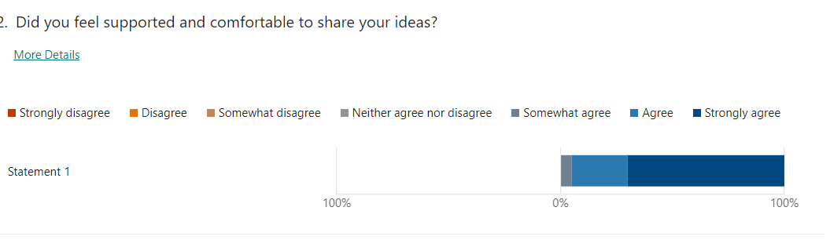
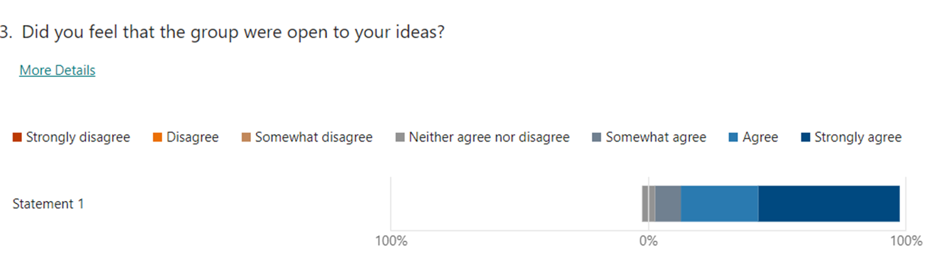
Coproduction Survey – LEAG Responses

Slide 6
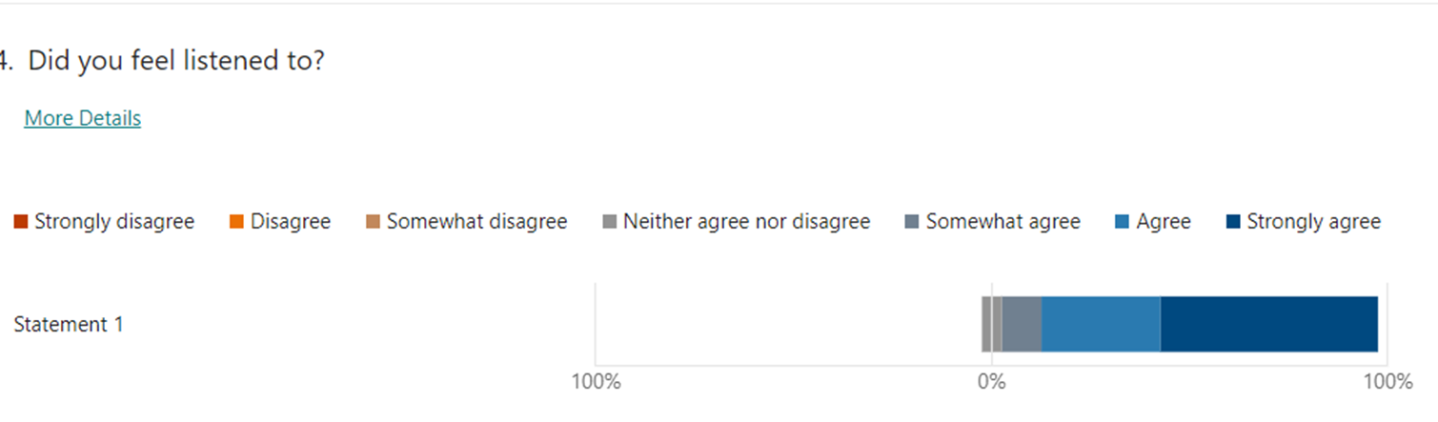
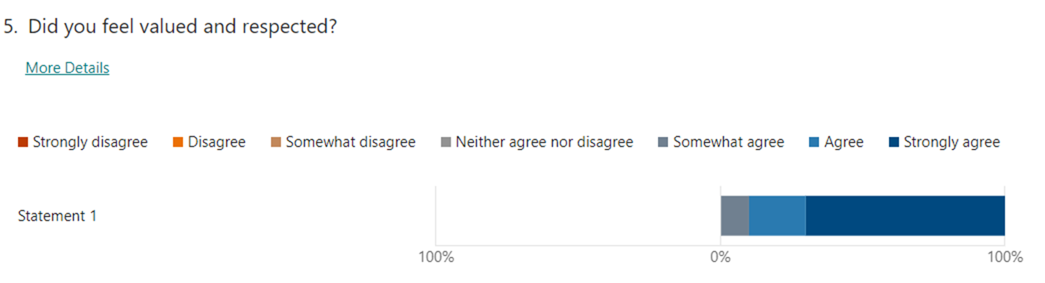
Coproduction Survey – LEAG Responses

Slide 7
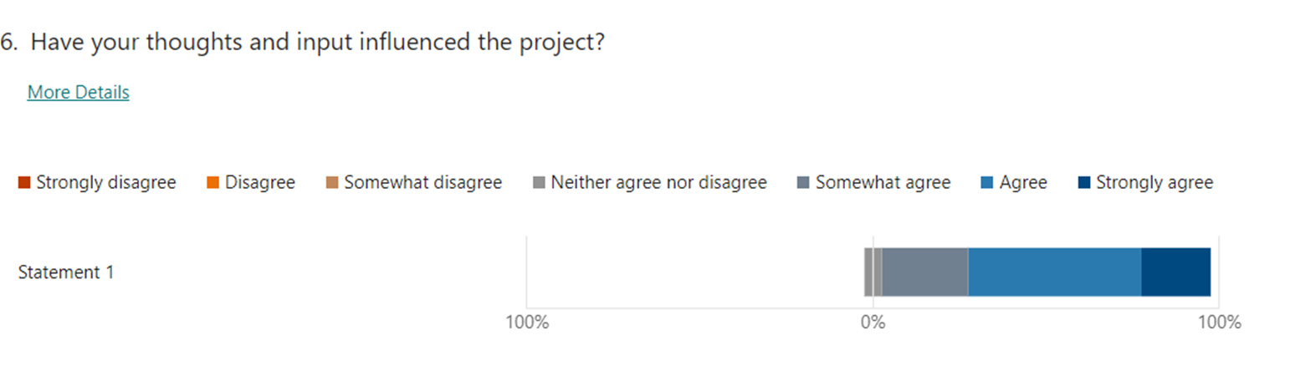
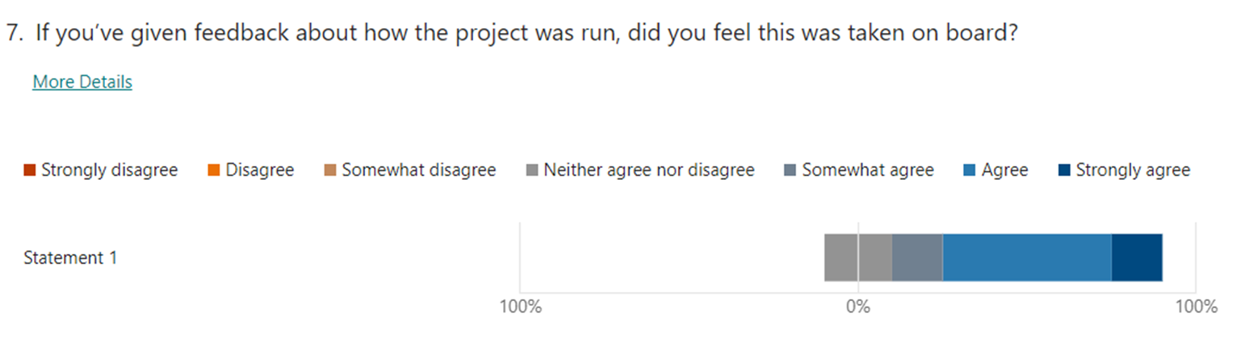
Coproduction Survey – LEAG Responses

Slide 8
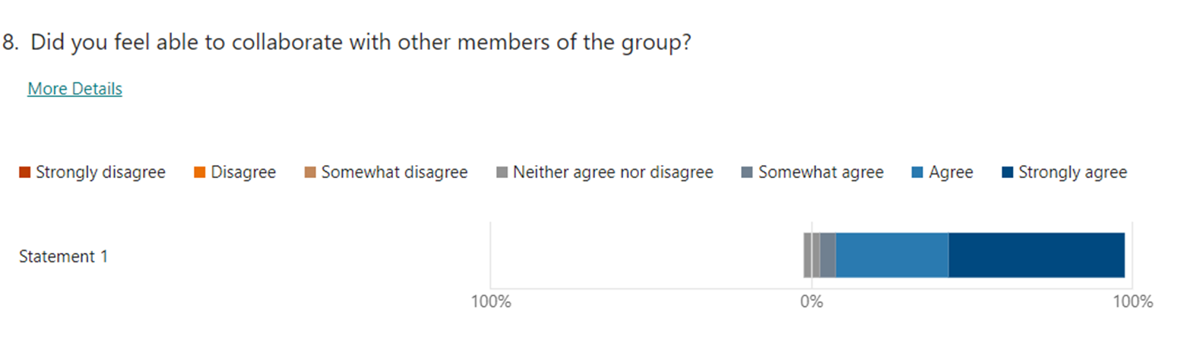
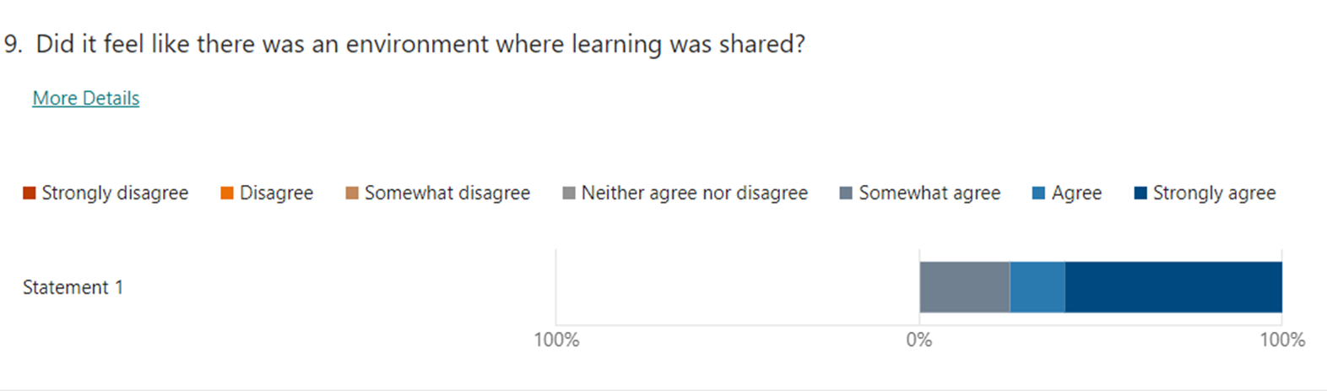
Coproduction Survey – LEAG Responses

Slide 9
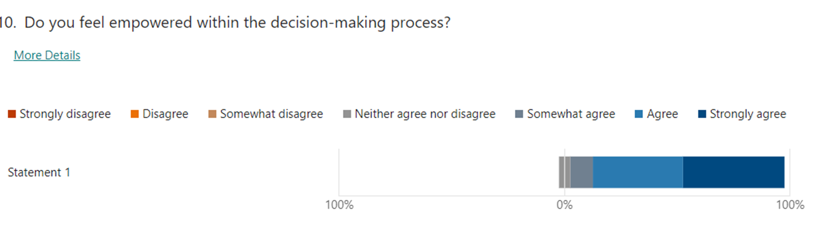
Coproduction Survey – LEAG Responses

Slide 10
learning and reflections
Strive harder to obtain funding for meaningful pre-grant involvement
Give more thought to inclusivity and diversity when recruiting team members, e.g. Black Thrive Global
Consider how LEAG members, especially those with no research experience, could better understand a complex project at the outset.
Facilitate the early building of trusting relationships amongst LEAG members
Regularly reviewed co-designed and coproduced impact log to include LEAG and researchers’ perspectives regarding impact.

Slide 11
learning and reflections
Greater clarity about the purpose and values of co-production at the start of the project
Review the Ways of Working document regularly to ensure it is still fit for purpose
Coproduced newsletters from the outset. For over a year, the team have produced project newsletters that have been shared with the LEAG in response to their request to be kept updated.
Circulate the coproduction survey co-designed with the LEAG from the get-go

Slide 12
learning and reflections
Find more creative ways to promote equal partnership working.
Upskill those academics with little or no knowledge of coproduction values
Invite LEAG members to co-present at events
LEAG invited to join monthly wider team meetings
Greater focus on building capabilities with the LEAG

Slide 13
Co-Leadership
What would have helped:
More opportunities to build skills and capabilities
Independent supervision/mentoring
Dedicated reflective practice sessions with co-lead
Greater clarity regarding role and responsibilities

Slide 14
PPI Evaluation
Alison Faulker is conducting an independent evaluation of the PPI in MINDS:
Activities included:
Interviews with LEAG members, academics and co-leads
Written responses to a questionnaire
In-person PPI creative shared learning day

Slide 15
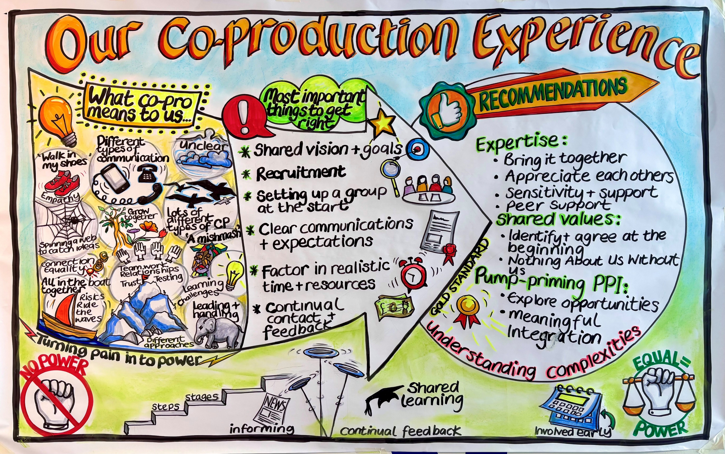

Slide 16
Themes emerging
Coproduction positives included coming together, on a journey, feeling of empowerment, ‘love working with like-minded people’, passionate, your voice being heard, having equal value.
Coproduction changed throughout the study and was different in different work packages. WP2 was felt to be closer to the concept of co-production.
It was felt that more time could have been taken at the start to establish a shared vision and the coproduction approach
The LEAG was felt to be less involved overall than other elements of the project (such as leadership and lived experience researcher involvement) and was positioned by some participants at the information level of the co-production ladder

Slide 17
reccomendations
Build in support for everyone from the start.
Appreciate each other’s expertise – co-production is about bringing together many different experiences and types of expertise.
NIHR to build the infrastructure and governance to support PPI in more practical ways, that ensure researchers are rewarded for doing PPI
Keep reviewing co-production throughout the project – don’t leave it until the end
Ensure or build a shared vision from the start

Slide 18
ImmunoMind
ImmunoMind is one of the six Mental Health Platform hubs: https://www.mentalhealthplatform.ac.uk/
Aims:
The hub aims to find causal pathways by which immune and metabolic factors lead to severe mental illness, forming a basis for new, personalised therapeutics that are precisely matched to the patients most likely to benefit.

Slide 19
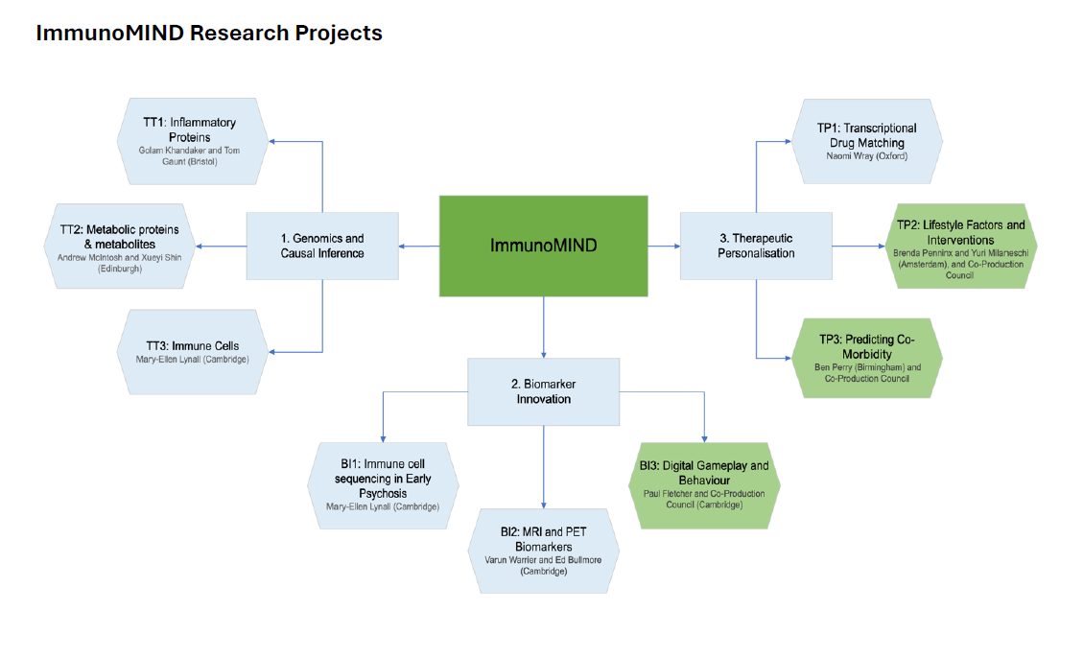

Slide 20
IMMunomind coproduction council
Work in equal partnership with scientists and researchers to coproduce three co-led therapeutic personalisation projects with the dedicated teams
Bring diverse experiences and expertise to the programme
Ensure that the programme's outcomes are relevant and useful to patients and the public by rigorously examining and/or challenging research outputs for the benefit of patients
Efficiently manage the PPI budget
Ensure information is updated, accessible and tailored to the needs of patients and the public.

Slide 21
Coproduction Council Budget Allocation
Research forums/Council meetings | Training and development
Impact and evaluation | Budget planning
Gameplay co-led project | Meeting planning
Lifestyle factors co-led project | Knowledge exchange planning
Predicting co-occurrence co-led project | Get to know you planning
Website | Papers and blogs
In-person meetings plus travel | NIHR uplift
Dissemination e.g. infographic | Contingency

Slide 22
For debate and Discussion
How do you genuinely involve experts by experience with no or little research experience in highly complex or technical research?
Do you believe authentic coproduction can be achieved in research? If not, what are the biggest barriers
Would you or do you coproduce research with people with lived experience? If yes, how would you, or are you, promoting equal partnership working?

