Slide 1
Developing a practice-based guide to good ethical conduct in public involvement in health research
Jim Elliott
Independent expert in public involvement in health research
Former Public Involvement Lead at the Health Research Authority
On behalf of the Ethics of Public Involvement in Research Development (EPIRD) team

Slide 2
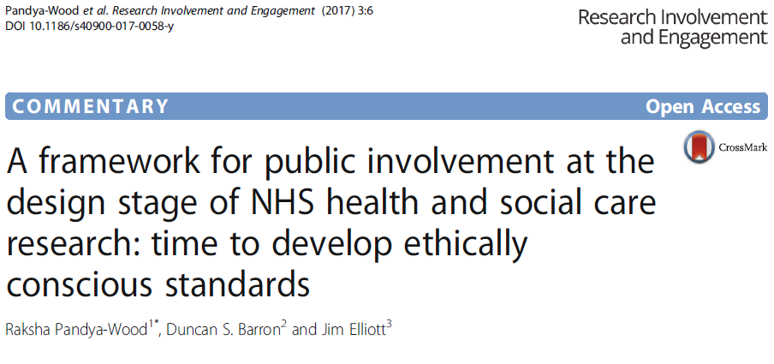
Paper based on issues raised in consultations between NIHR Research Design Service Public Involvement advisers and researchers.
Framework [for consultation] presents issues and possible solutions for use in practice (2017).
Notes:
Paper published in April 2017 to develop a draft ethical framework for involving patients and the public in the design of studies

Slide 3
A co-produced practice-based guide to ethical public involvement
Ethics of Public Involvement in Research Design (EPIRD) Team:
Duncan Barron, CPE, Kingston & St George’s
Jennifer Bostock, Public Contributor / NHS REC member
Jim Elliott, Health Research Authority
Lucy Frith, NIHR RDS North West
Victoria Hamer, Public Contributor
Julie Hapeshi, NIHR RDS South West
Delia Muir, NIHR RDS Yorkshire & Humber
Raksha Pandya-Wood, NIHR RDS East Midlands

Slide 4
Background to 2017 paper
First-hand experience of advising researchers at the research design stage (Duncan & Raksha)
Concept and ideas first presented at the INVOLVE conference in 2010 (framework comprised only 3 issues)
Framework developed through further practice & informal consultations across UK into 10 issues for publication in 2017 (Jim joined to bring in research ethics perspective)

Slide 5
Draft framework 2017
“An ethically conscious framework for public involvement at the research design stage”
10 areas where ethical issues may arise
Potential ethical issues identified for each area
Solutions to each of the issues suggested, including any relevant and available guidance
Published as a draft with a recommendation for consultation to look for further issues & consensus

Slide 6
Development of draft framework
Consultation on framework including workshops with members of the public & researchers
Refining of draft framework added 11th issue
Refined framework mapped against UK Standards and Values and Principles Framework to develop a draft practical guide to good ethical practice for involving the public in health research, March 2020
Covid-19 & development of Shared Commitment halted further work

Slide 7
E
Open, clear and sensitive communications between everyone involved
Communicating clearly from the outset
Entitling public contributors to stop their involvement for any reason
Differentiating between public involvement and qualitative research methods
A
Detailed Planning
Allocating sufficient time for public involvement
ETHICAL
PUBLIC
INVOLVEMENT
IN
RESEARCH
DESIGN
E P I R D
D
Support from organisations through policies and processes that provide safety, transparency and confidentiality
Seek support / Register with R&D Office
Confidentiality
Safeguarding
B
A shared sense of purpose and mutual respect
Avoiding tokenism
Rewarding & Valuing
Involvement
Fairness of opportunity
C
Reaching enough of the right people, with enough, varied, appropriate, fair, and transparent opportunities/ways
Fairness of opportunity
Working sensitively
Notes:
VH: We have a wonderful star which shows all the aspects which PPI and Ethical considerations come together. One of this is Safeguarding both for adults and for children and young people which we touched on earlier. Sensitivity is another aspects – which Sunnie has raised today. Talking about research, talking about how to help research by PPI, could bring back memories of the condition being researched, and researchers need to be aware of that possibility and make contingencies in case that occurs.
Another point of the star goes to Fairness of Opportunity. This takes us back to ‘Ask’! It also takes us back to Children and Young People. It is only Fairness of Opportunity for the Young People, it is Fairness of Opportunity for the Researchers to have access to the views and reactions of the young people to their research. The YPAG, the Young People’s Advisory Group, when their voice was heard, meant that the researchers went straight back to the drawing board to start again. How much time the YPAG had saved the researchers by making sure that the concept and the visuals and the wording were young-people friendly and this was for a very sensitive topic. Interesting take on ‘Power Imbalance”!
In some ways, if we think about doing things ‘ethically’ and in a relationship-based way, I think that PPI can go almost as far as the lay person is happy to go. Apart from doe the lay people think that the research itself is ethical, the lay people can suggest wording improvements, suggest diagrams, suggest more easily readable fonts, can query, query, query what and who and for how long and is it really necessary and can it be done some other way. It is all important to the hoped-for success of the proposed research.
And a Positive Shout Out for the ethically conscious British Heart Foundation – both, naturally, in their research, but in this instance, also for their PPI. They have a large Patient Advisory Group (on which my extended term has come to an end). This group comments not only on the research proposal, but also on the quality of the separate PPI section where researchers have to say specifically how and with whom they have consulted on PPI matters. The BHF sends out the papers well in advance, tells the Patient Advisory group when to expect them, and when to return them by. Both the Patient and Public Manager, and Officer respond to queries very promptly and helpfully, arrange travel and accommodation as needed, but also offers the option of joining online if health or logistical reasons might otherwise prevent attendance, set up lab tours of interest to the Patient Advisory Group – in short make the PPI members feel very valued and appreciated. They are a model. A Star in fact. And here’s to another Star!

Slide 8
Next steps 2025?
EPIRD Team regrouped to pick up from 2020
Need to build on the significant rise in publications on the ethics of public involvement
Considerable interest & development from other teams in UK & globally
Opportunities for coordination and collaboration to be explored
Clear need for alignment with UK Standards for Public Involvement to promote awareness & uptake of ethical approaches to involvement

