Slide 1
Use of creative tools and practices in the VCSE that support ethical practice in research
Ang Broadbridge

Slide 2
Ways to Wellness – test and learn approach
Prototyping not piloting (rapid test and learn with service user & service provider led design) – children with complex medical needs / persistent physical symptoms / LTC / perioperative
Understand local context and build on existing assets
Connect widely across the local system
Challenge existing ways of doing things that get in the way of collaborative approaches
Build a supportive Learning Community approach – recruitment, training, spaces for reflection (see Fuse blog)
Capture impact through stories, numbers and outcome measure as a route to sustainability

Slide 3

















Upskilling VCSE teams as research activated practitioners
Rapid test and learn
Evaluation early
Commissioner input
Link with ARC academic studies
Steering groups (internal and external)
Learning community
‘Working out loud’ visible comms
Triangulate learning - system learning community workshops
Central MIS and data
dashboard
Valuing lived experience
Training budget
Strong governance – discrete rigour
RISK
Flex in budget for peer support groups
Small personal budgets for patient needs
Clinical supervision
Connect into national networks related to prototype area
Risk management – financial, operational, resource, safeguarding

Slide 4
Creative tools and practices
Peer and participatory research
Wellbeing Star and other assessment and monitoring tools “I’m contributing things to that MDT that no-one else knows about and it’s valued”
Motivational interviewing training
“Human service workers as facilitators of inquiry” – Yoland Wadsworth
Neutral venues
Critically assessing practice – get curious, take a step back, look through different lenses
Wrap around care for others
…Workers have learned to be alert, curious and questioning “the way we do things around here” easily switching into observe – reflect – plan –do…” (Wadsworth, Human Inquiry for Living Systems)

Slide 5

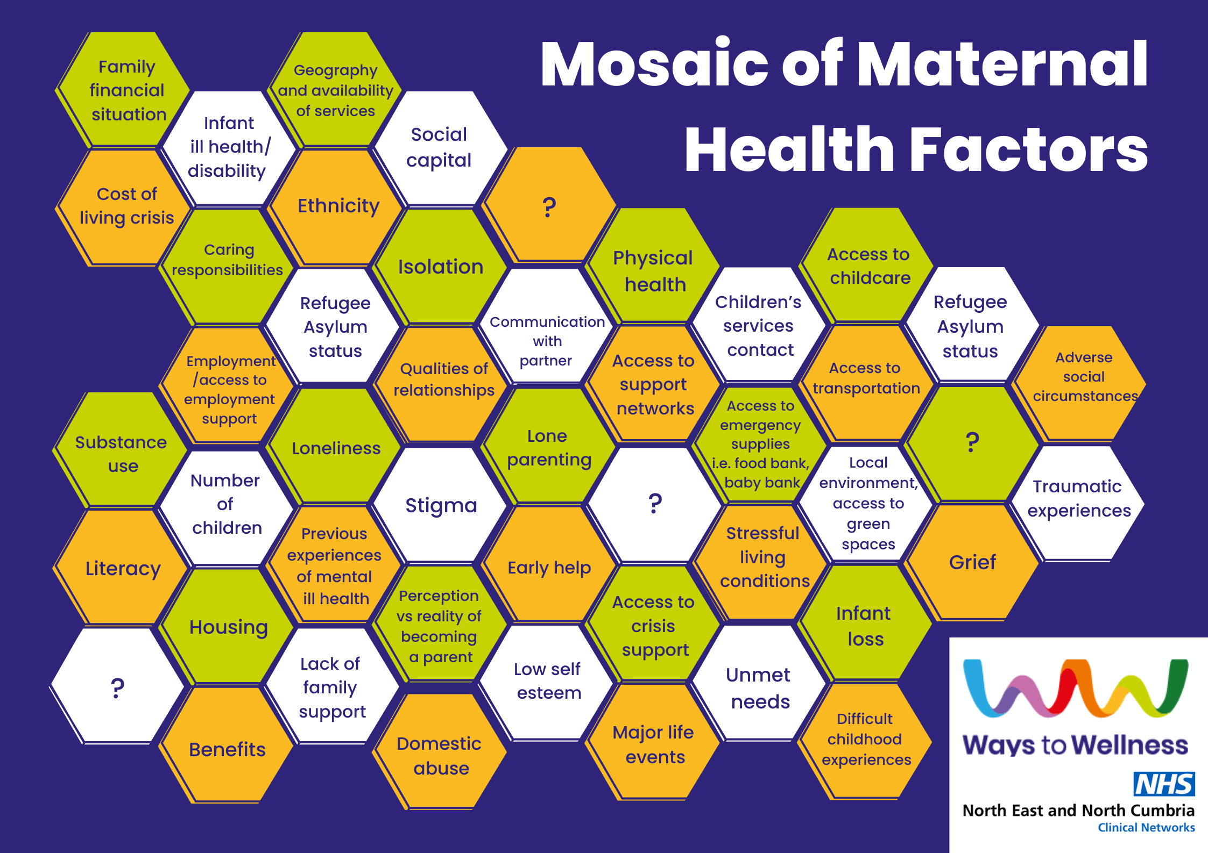
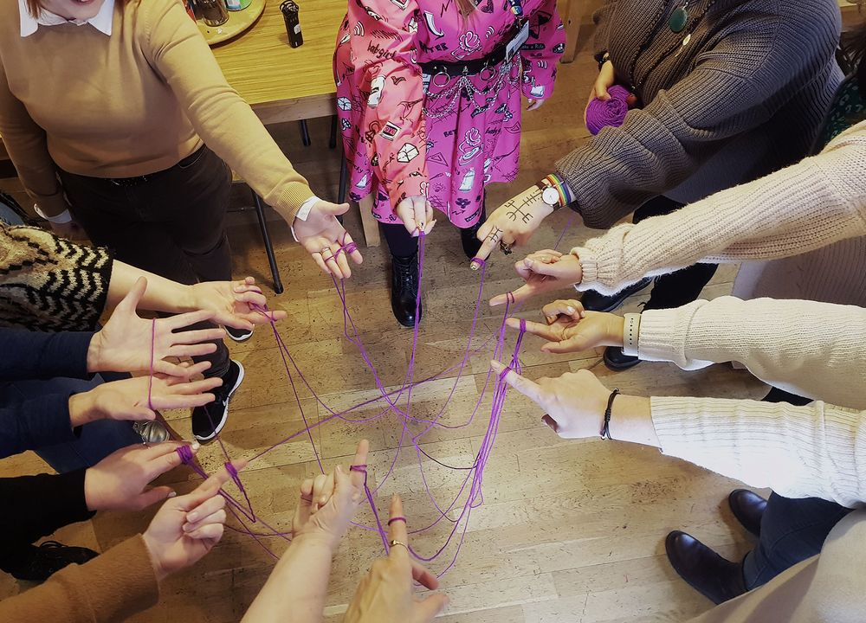
Three examples of participatory projects
Creative participatory workshops with Centre for Digital Citizens leading to development of animation around underheard voices with Happy Mums
Mosaic of maternal mental health factors
Beginning to explore youth voice in our SPACE Pilot

Slide 6
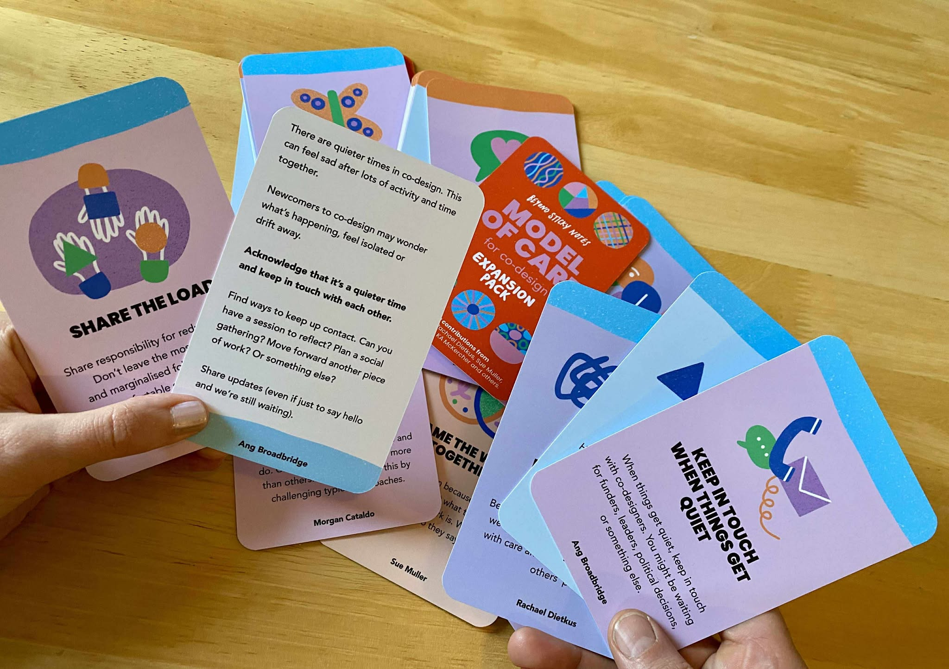
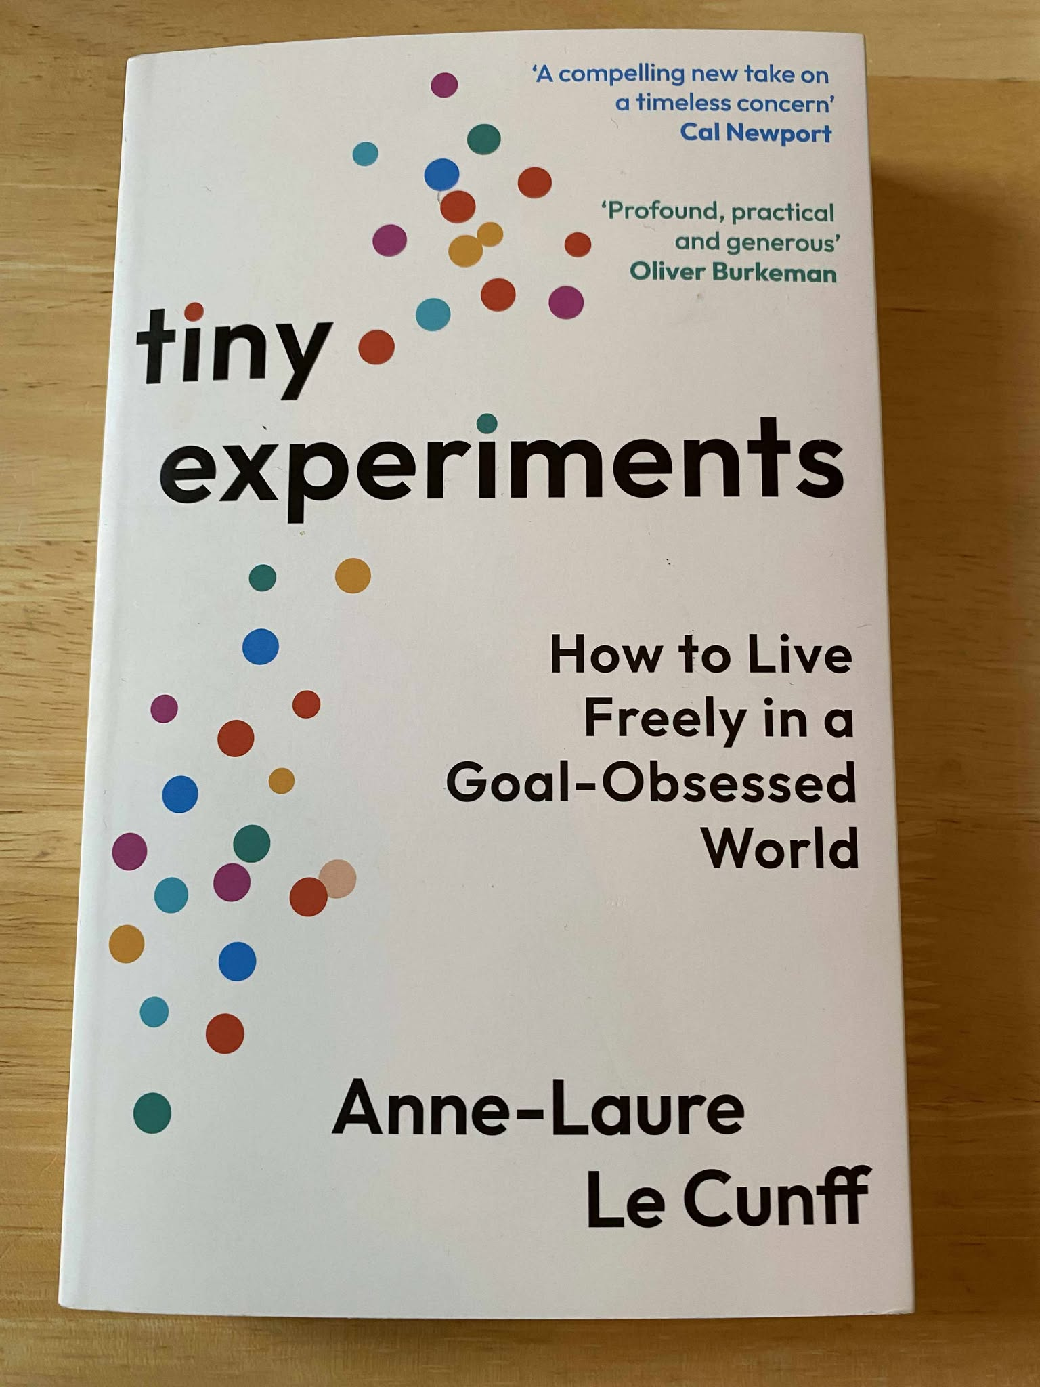
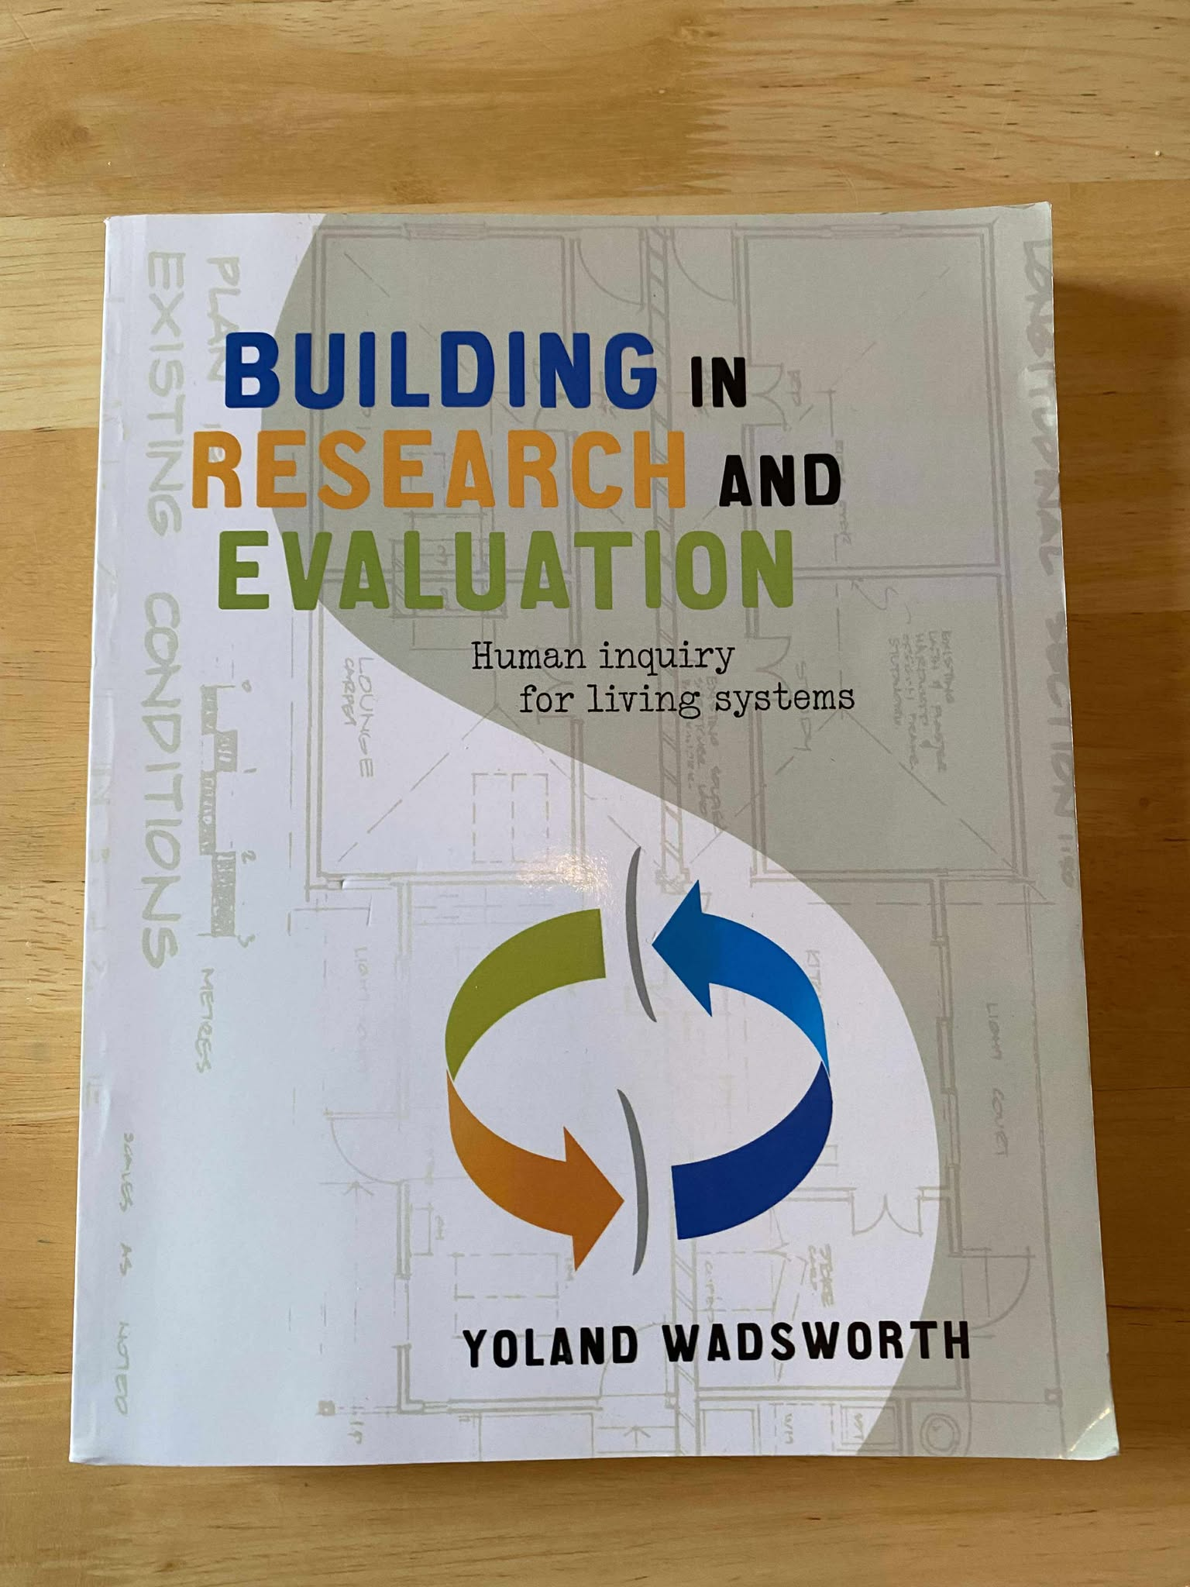
Resources to support ethical practice
Model of Care for Co-design Expansion Pack — Beyond Sticky Notes

Slide 7
A question of parity?
Many VCSE organisations now have their own ethical research guidelines and internal ethical review processes
Challenges around parity – access to resources, pace at which things move, grey literature, publishing (shifts –practice guidelines, Hidden REF, training)
More opportunities for VSCE practitioners to have hybrid roles in practice and research
“Having encountered a perception that research conducted in the voluntary and community sector is not as rigorous as traditional academic research, Ways to Wellness developed its own ethical research guidelines and uses resources pragmatically, drawing appropriately on external expertise to build evaluation into prototypes from the outset”
Research Matters (forthcoming)

