Slide 1
NIHR ARC
East of England

Slide 2
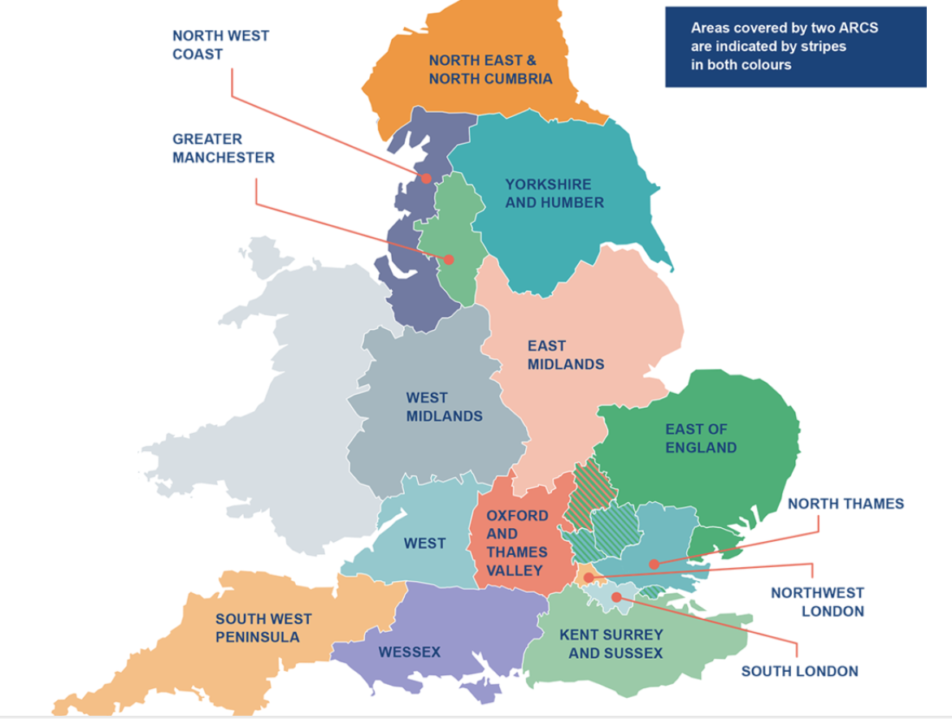
What do NIHR Applied Research Collaborations (ARCs) do?
NIHR ARCs support applied health and care research that responds to, and meets, the needs of local populations and local health and care systems.
An initial £135 million investment in 15 ARCs across England, to support applied health and care research that responds to and meets the needs of local populations and local health and care systems. The five-year investment has been extended by 18 months until 31 March 2026.

Slide 3
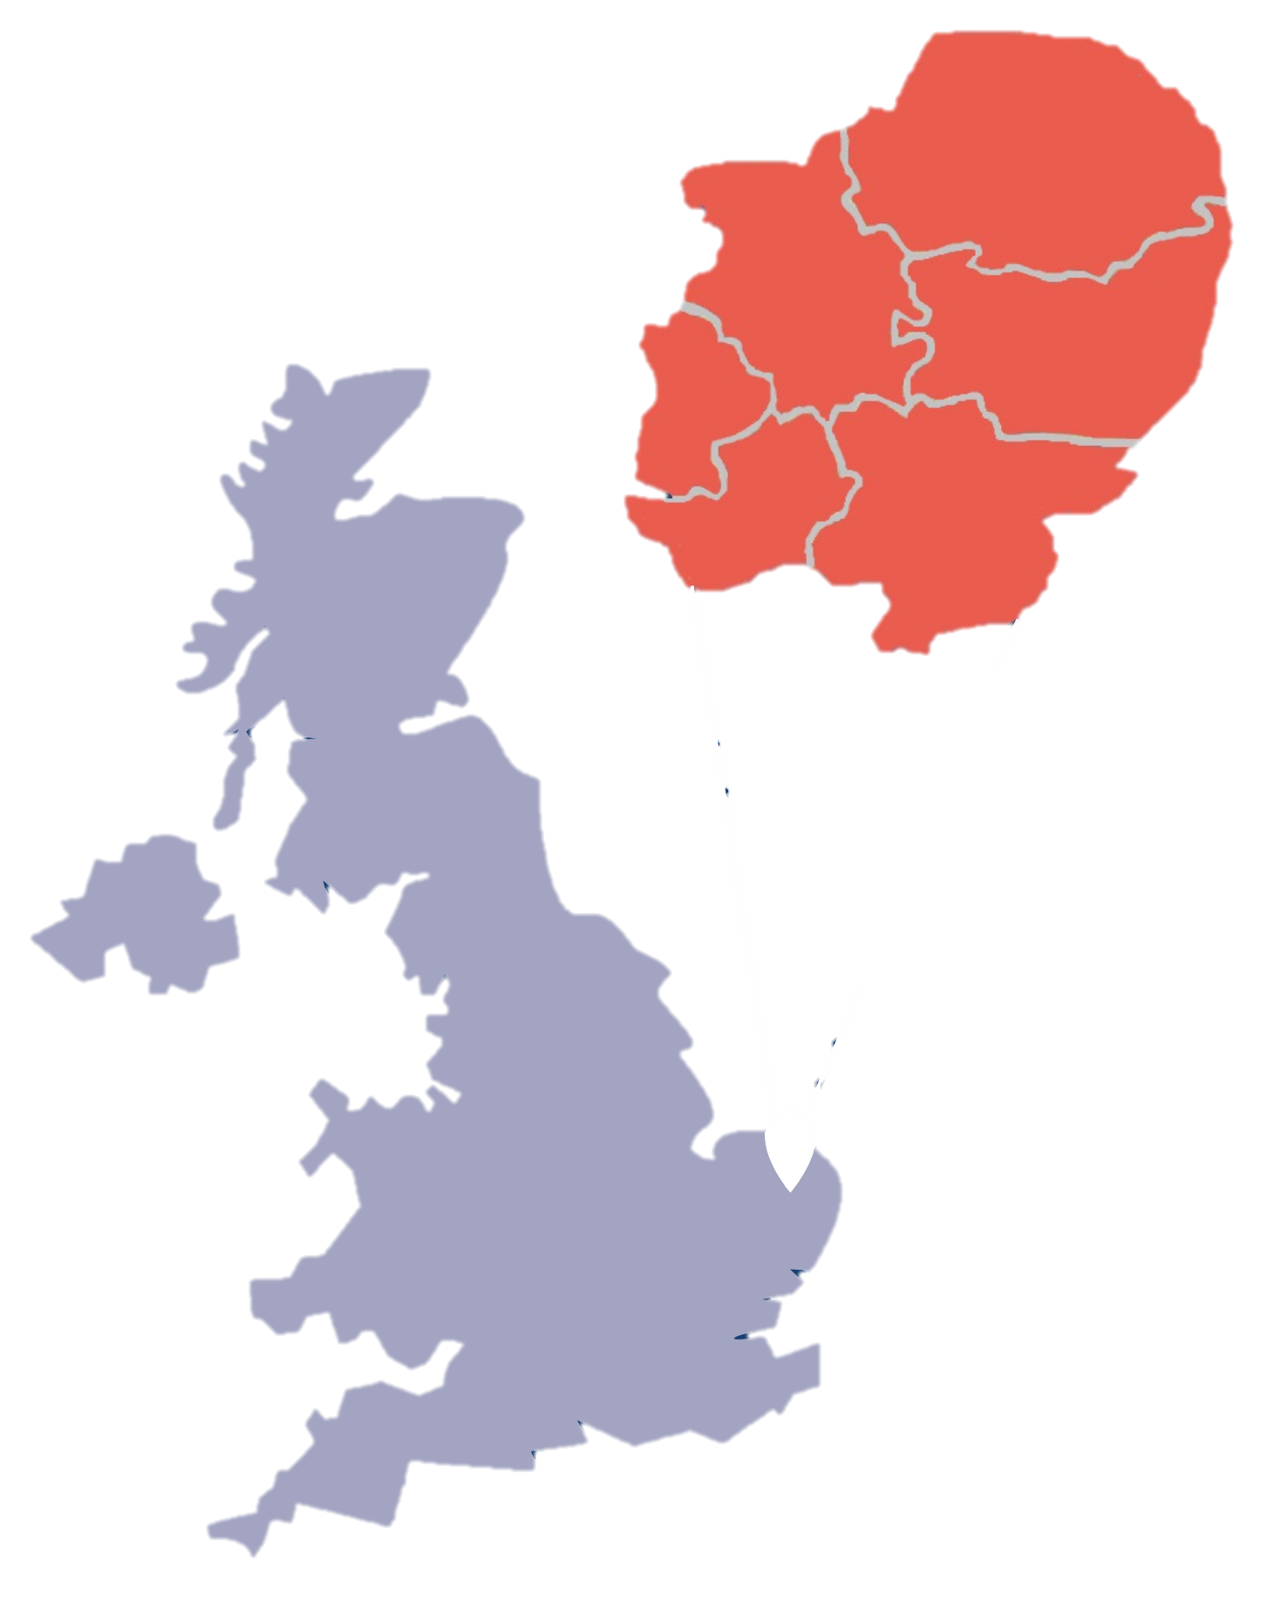

NIHR ARC East of England
A collaboration between:
Cambridgeshire and Peterborough NHS Foundation Trust (host)
University of Hertfordshire, University of Cambridge, University of East Anglia, University of Essex, Anglia Ruskin University
Health Innovation East
Integrated Care Systems, NHS Trusts, local authorities, patient/community organisations, charities, and industry partners across the region.

Slide 4
NIHR Applied Research Collaboration East of England
We aim to:
Achieve impact regionally and nationally through developing a culture for collaborative and applied health and are research.
Enhance research capacity and embed implementation practice.
Develop deep and sustainable engagement with local populations, creating measurable improvements in health and care.

Slide 5
What we do
Applied Health and Care Research
Engaging and Involving the Public and Communities in Research
Increasing Research Knowledge and Skills Across the Region
Putting our Research into Practice

Slide 6
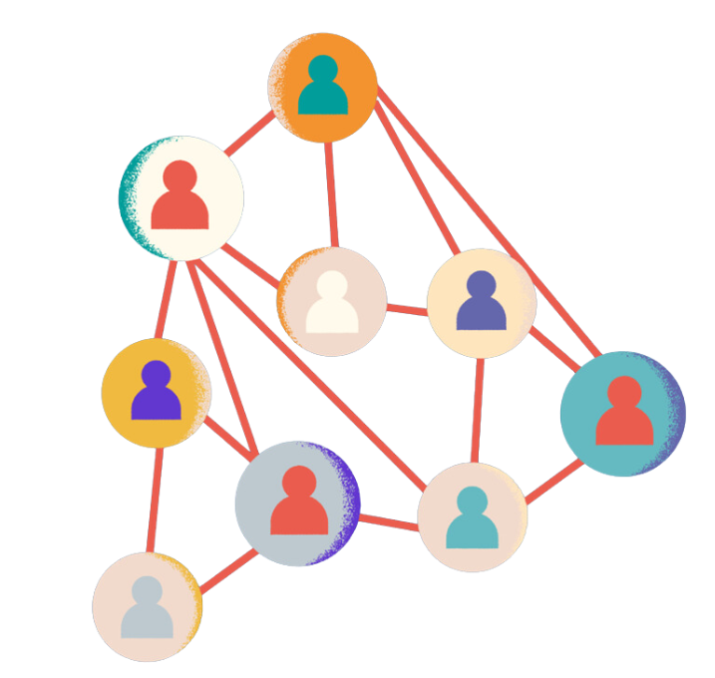
Applied health and care research
  Across 6 Research themes, bringing together health and care professionals, researchers and communities to find practical solutions to local health and care problems.
  Inclusive Involvement in Research
  Led by Elspeth Mathie (UH)
  Prevention and Early Detection in Health and Social Care
  Led by Claire Thompson (UH)
  Measurement in Health and Social Care
  Led by Adam Wagner (UEA)
  Mental Health over the Life Course
  Led by Kristy Sanderson (UEA)
  Support for Ageing and Living with Long-term Conditions
  Led by Kathryn Almack (UH)
  Palliative and End-of-Life Care
  Led by Morag Farquhar, UEA)

Slide 7

Engaging and involving the public and communities in our research
Research projects
Public contributors in advisory groups, panels, co-production and partnerships
Governance structures
Public contributors on ARC Board, Expert Advisory Group, Academic Career Development, Public, Community Involvement Engagement and Participation (PCIEP) Coordinating Group, Public Involvement Hub
Regional and national partnerships
National ARC meetings, NIHR Inclusion Steering Group (East of England), member of Shared Commitment to Public Involvement

Slide 8
Increasing research knowledge and skills across the region
Fellowship programme
Focuses on local applied research, evaluation and implementation projects, building local capacity for evidence-informed practice
Early Career Researchers
Workshops and support for development of early career researchers
ARC PhDs
Funded PhD students within ARC themes
Dementia Postdoctoral researchers
Supporting career development awards for early career researchers in dementia, and building strength in dementia-related applied health and care research
Social Care Research Capacity
strengthening research capacity in adult and children’s social care
Knowledge Mobilisation
Building knowledge mobilisation capacity and capability within the health and social care system to get effective treatments and models of care into practice

Slide 9
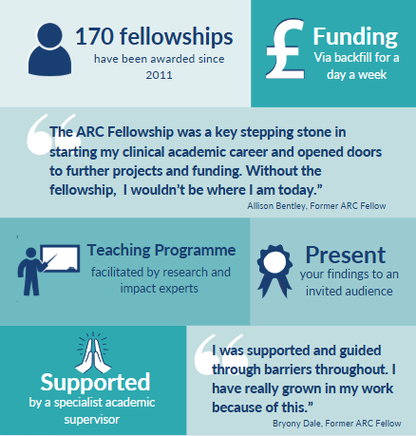
ARC East of England fellowship programme
The ARC Fellowship offers health and care professionals and voluntary sector staff across the East of England an opportunity to develop skills and an understanding of research and research implementation methodologies.
We recruit fellows from across the East of England from a wide range of clinical and non-clinical backgrounds in the health, care and voluntary sectors. No previous research experience is necessary.
Fellows undertake an applied research or impact project related to their role and organisation.

Slide 10


Putting our research into practice
The Knowledge Mobilisation and Implementation team supports themes and researchers to proactively plan for, and identify opportunities, for implementation.
This incorporates Knowledge Mobilisation, supporting themes to develop and embed Knowledge Mobilisation pathways in their projects.

Slide 11






























ARC East of England partners and collaborators*
*please note our partners change over time, this is a sample of who we have worked with

Slide 12
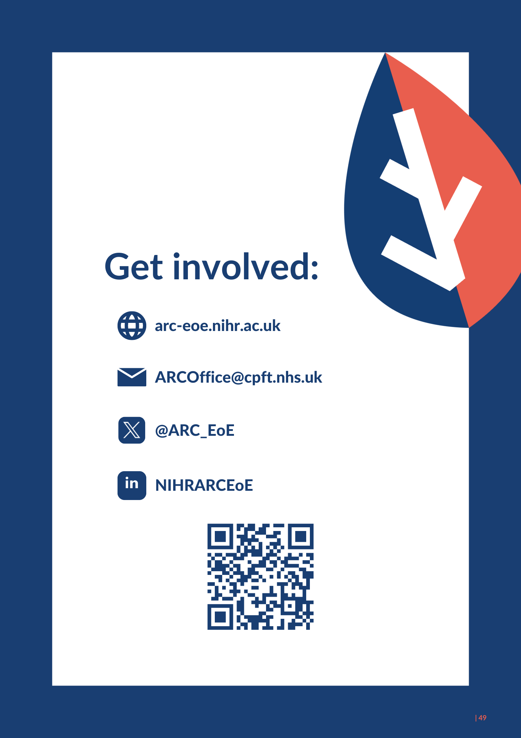
Learn more and get in touch

