Slide 1
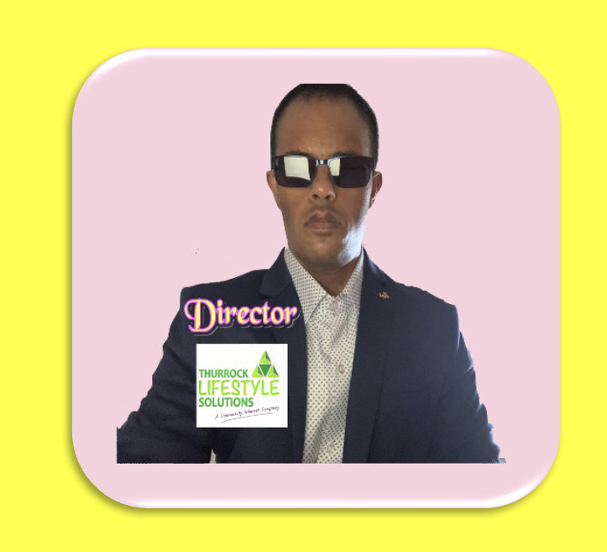
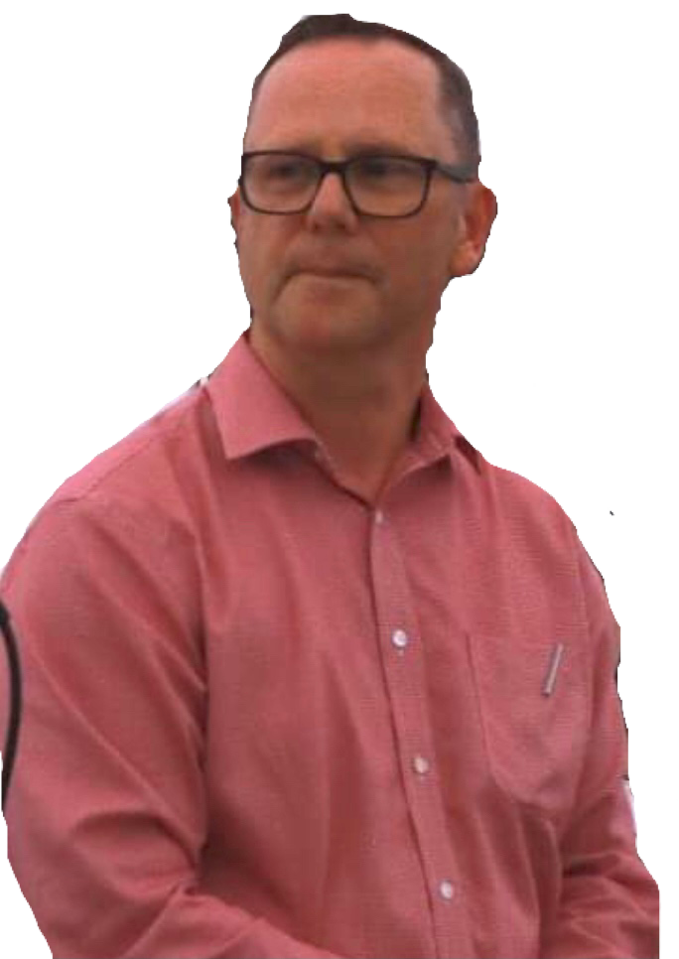

E.V.P ?
Equal Value Partner
Sunny Saini
Director
director@choiceandcontrol.co.uk
Neil Woodbridge
CEO
neil@choiceandcontrol.co.uk

Slide 2


REMOVE THE BARRIERS
Community is an experience and NOT a location

Slide 3
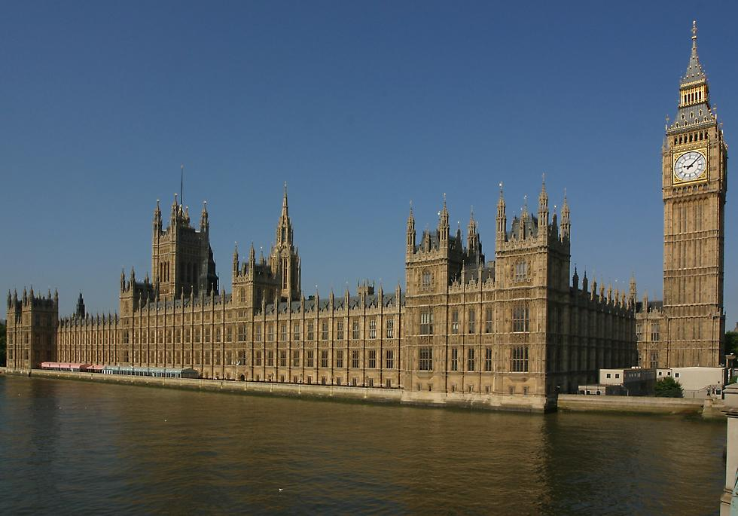


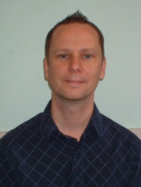
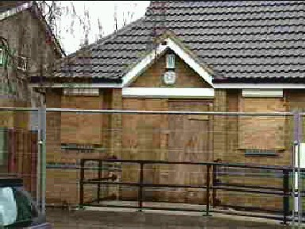



Slide 4

Community Interest Company. Director’s

Slide 5



What does a Director Do?
Community Interest Company
“Nothing about us without us”

Slide 6
Staff
Service Users
6

Slide 7
Community Interest Company
Directors
Disabled People
CUSTOMERS
Staff
7

Slide 8

Social enterprises are organisations that are run along business lines but where any profits are reinvested into the community or into service developments.

Slide 9
Is this just an empty ritual or do people have the power to affect the outcome?

Slide 10
We are born with two ears and one mouth for a reason.

Slide 11
Move from passive recipients of care to active citizens in control .. The lessons from voting??

Slide 12
Assume … means?

Slide 13
Participation rather than consultation

Slide 14
Identify your KIN

Slide 15
Those who imprison themselves within the confines of one model, only have the perspective of the Keyhole?

Slide 16
EVP
Two Ears one Mouth
Adapt Adapt Adapt – Make Accessible
Film … make one!
Time
ID your KIN
Empty Ritual – feedback (we Listen we Act)
Participation not Consultation
Principled Opportunity

